Slide 1

New York City Taxi Trip Duration
ShresHth Yash

Slide 2
Introduction
Introduction & Installation
Data Pre-Processing
EDA
PCA
Prediction
Clustering
Conclusion

Slide 3
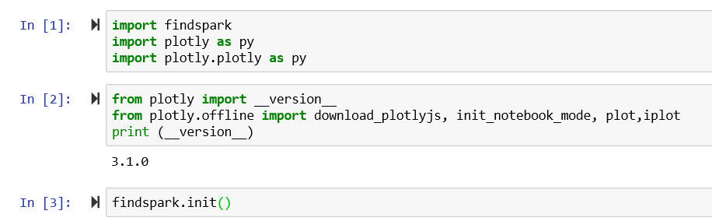
Installation
Installed Java and Spark remotely and created environment variables for JAVA_HOME and SPARK_HOME.
Installed Pyspark and configured Spark on Jupyter Notebook

Slide 4
About the Data
It is a fact that only about 22% of the residents in Manhattan own a car compared to the US national average of 91% at least one car. As a result of which, the number of taxi rides in New York City amount to approximately 200 million annually.
01
The data files comprise of 1.5 million records and 11 variables such as id, vendor id, pickup date time, drop off date time, pickup latitude, pickup longitude, drop off latitude, drop off longitude and trip duration.
02
Our goal is to predict the taxi duration based on other features like pickup and drop off date/time and locations.
03

Slide 5
Pre-processing
Loading Data and storing in the cache memory
Removing Outliers beyond 3 standard deviations away from mean
Feature Engineering of Date-Time field to separate date and time using unix time in pyspark.

Slide 6
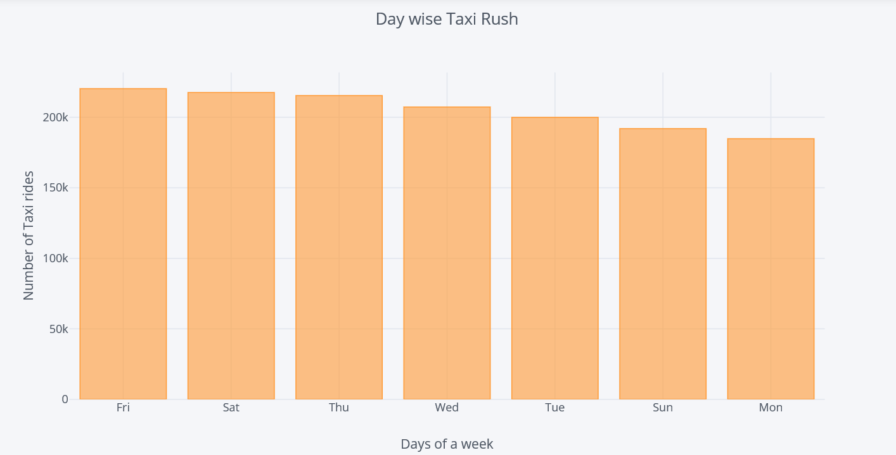
Number of rides dAILY
Monday the lowest pickup numbers and Friday the highest pickup numbers

Slide 7
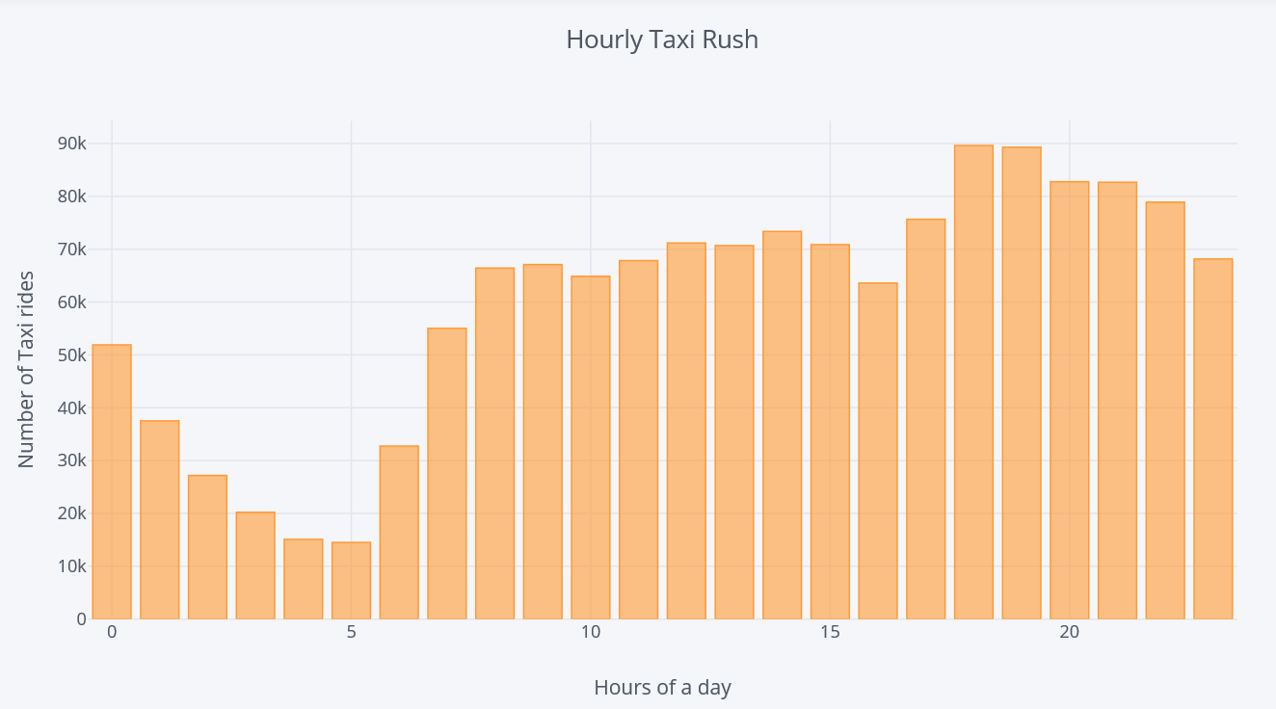
Number of Rides Per Hour
More rides were booked in the evening around 6pm to 9pm

Slide 8
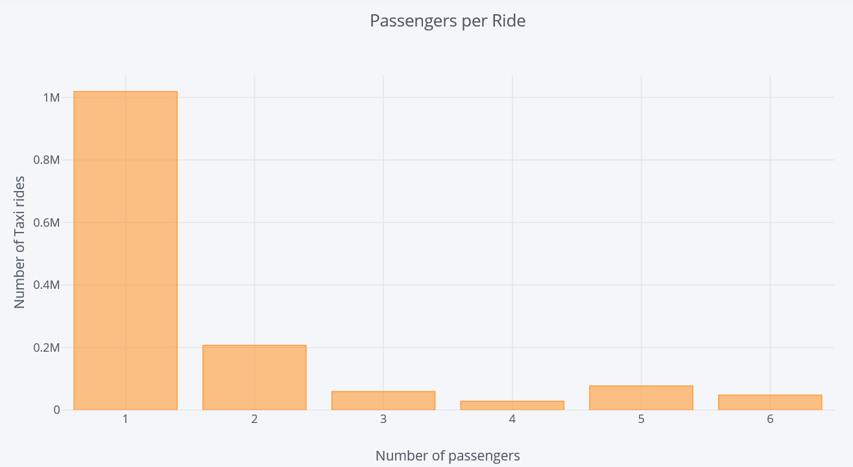
Number of Passengers per ride
Most rides were booked For a single passenger.

Slide 9
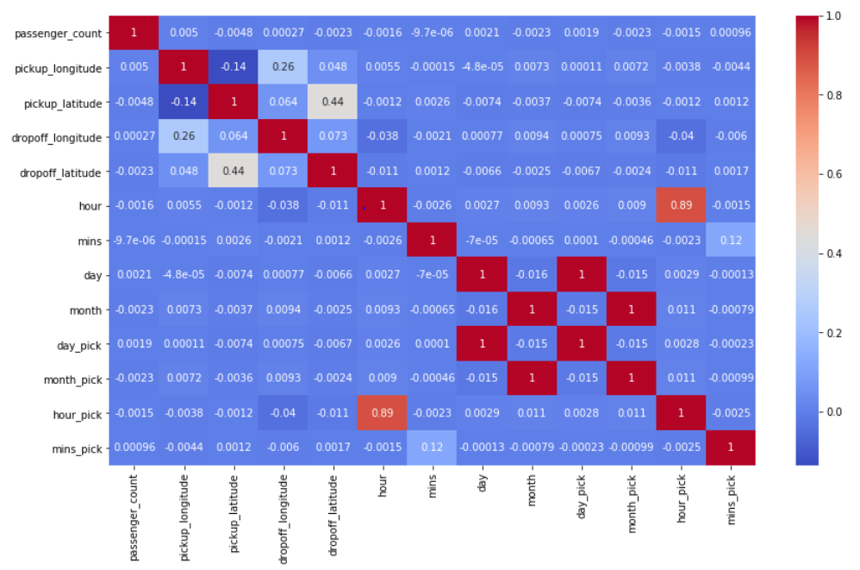
Heatmap
Heatmap colorscale shows the strength of correlation between independent variables
Most features depict a low level of correlation -> satisfies Multicollinearity assumption
High correlation between hour_pick & hour, day_pick & day, month_pick & month and mins_pick & mins -> dropoff and pickup datetime have almost similar values

Slide 10
Principal component analysis (PCA)
PURPOSE: Multivariate Analyses often create the problem of overfitting
Reduces the number of variables
Variables are independent of each other
Variables become less interpretable
WHAT PCA DOES

Slide 11
PCA Background
Performs dimension reduction – reduces a large set of variables to a small set that contains features that are most relevant for predicting the outcome variable
It is performed through the process of Feature Extraction where direction and magnitude of variables decide the principal components that explain the most variation
Choose the number of Principal Components on the basis of a scree plot or proportion of variance explained

Slide 12
PCA with pyspark
Use VectorAssembler and pyspark.ml.feature libraries in PySpark
Scale features using StandardScaler -> Variables have different units
Normalize variables (center around mean)
Choose number of Components
Apply PCA

Slide 13
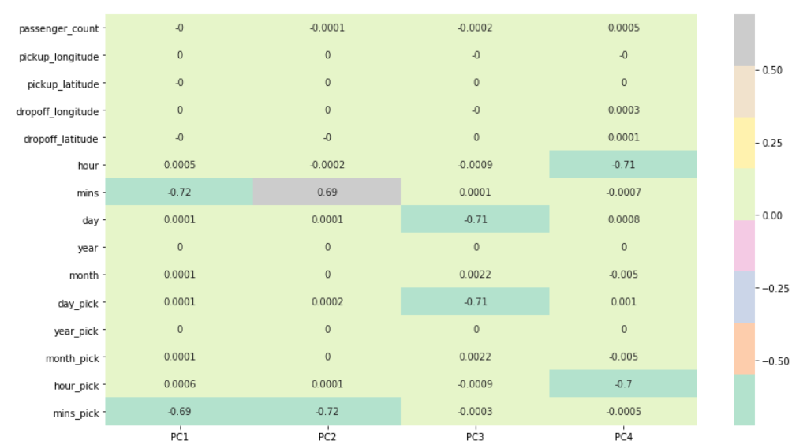
Feature Importance
The heatmap and the color bar represent the correlation between the various feature and the principal component itself
4 Principal Components
Higher the correlation, more the principal component related to a feature -> represented by the colorscale

Slide 14
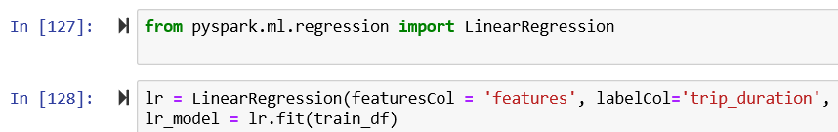
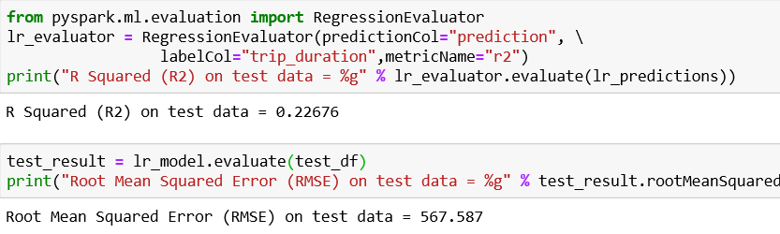
Linear Regression

Slide 15
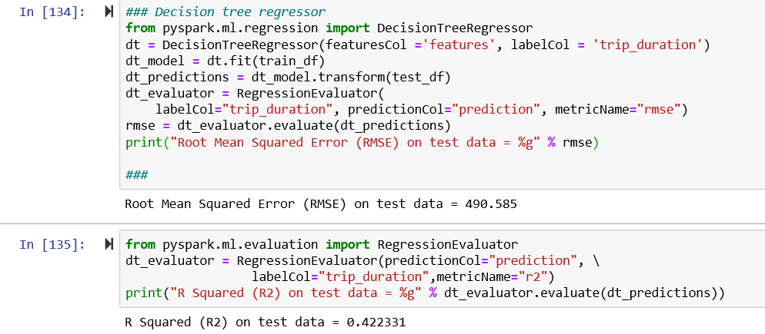
Decision Tree Regressor

Slide 16
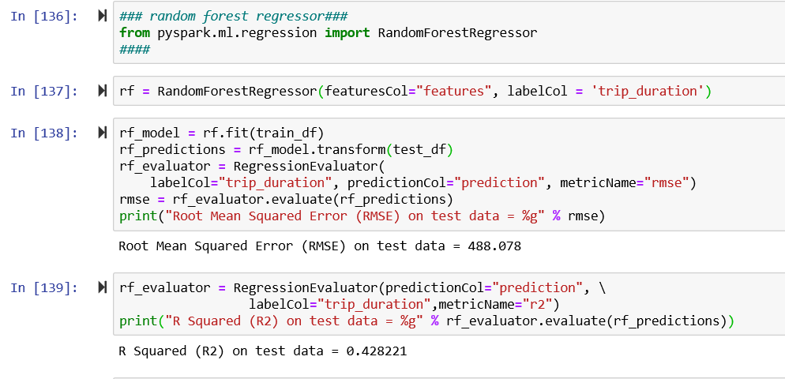
Random Forest Regressor

Slide 17
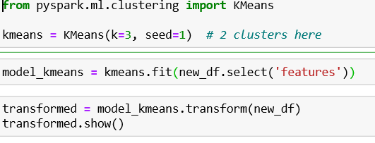
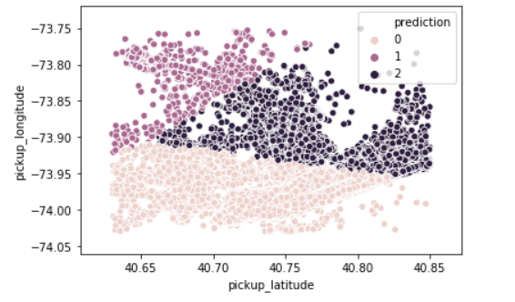
K Means Clustering

Slide 18

Conclusion
Monday the lowest pickup numbers and Friday the highest pickup numbers
More rides were booked in the evening around 6pm to 9pm
Most rides were booked For a single passenger
Random Forest regression predicted the beast accuracy out of all the three with r^2 = 0.428

